Slide 1
Remote Monitoring of quality and potability of drinking water resources
Govt of Uttarakhand
Team DevRushi Eco Projects

Slide 2
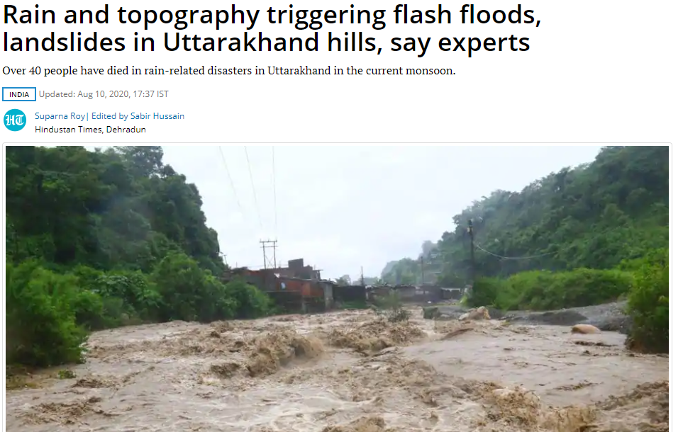
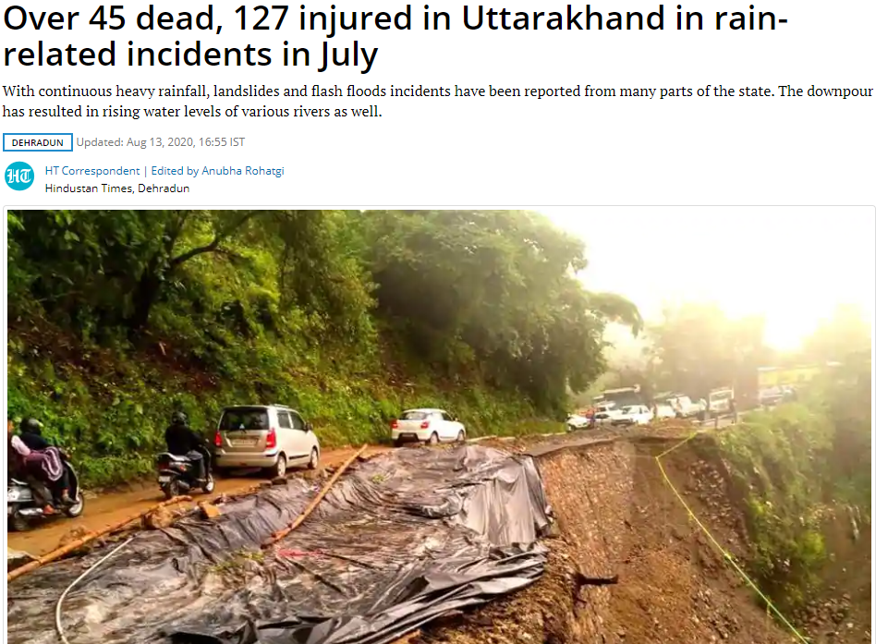
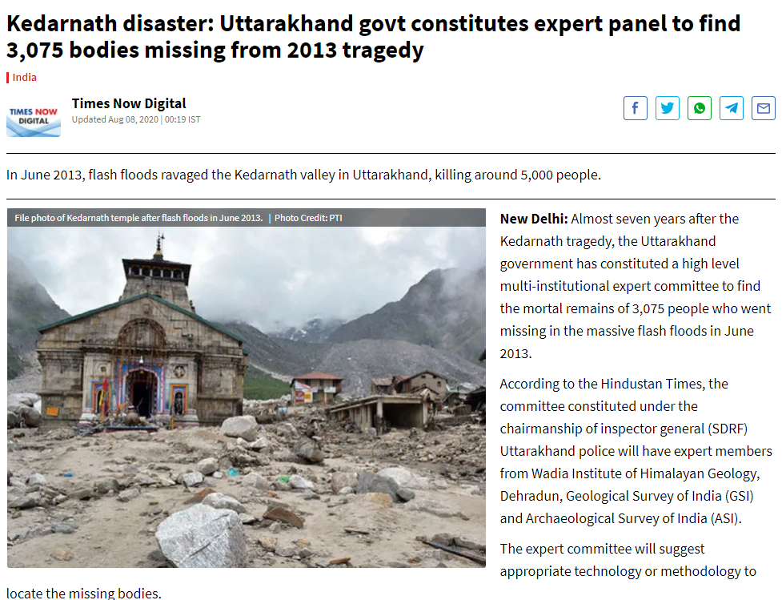
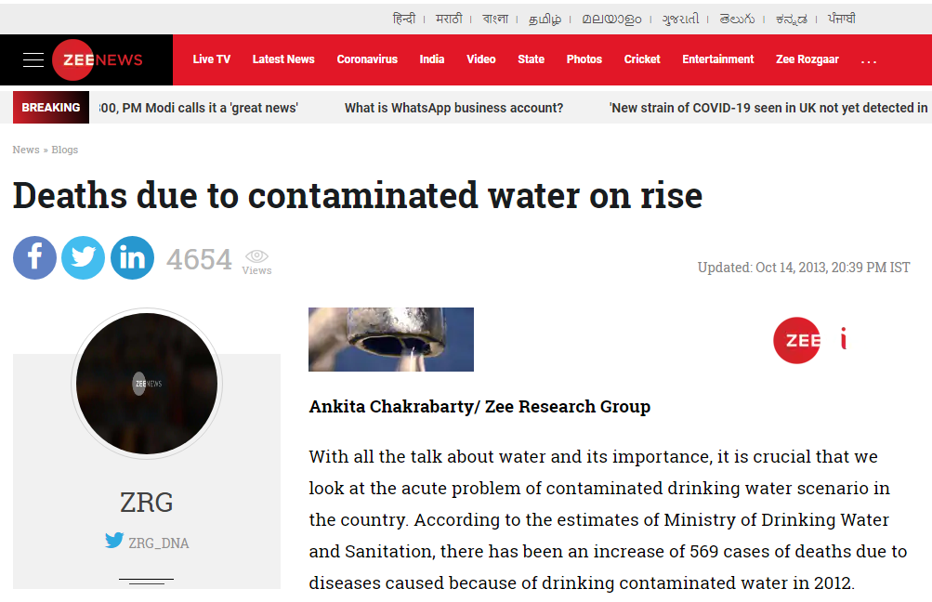
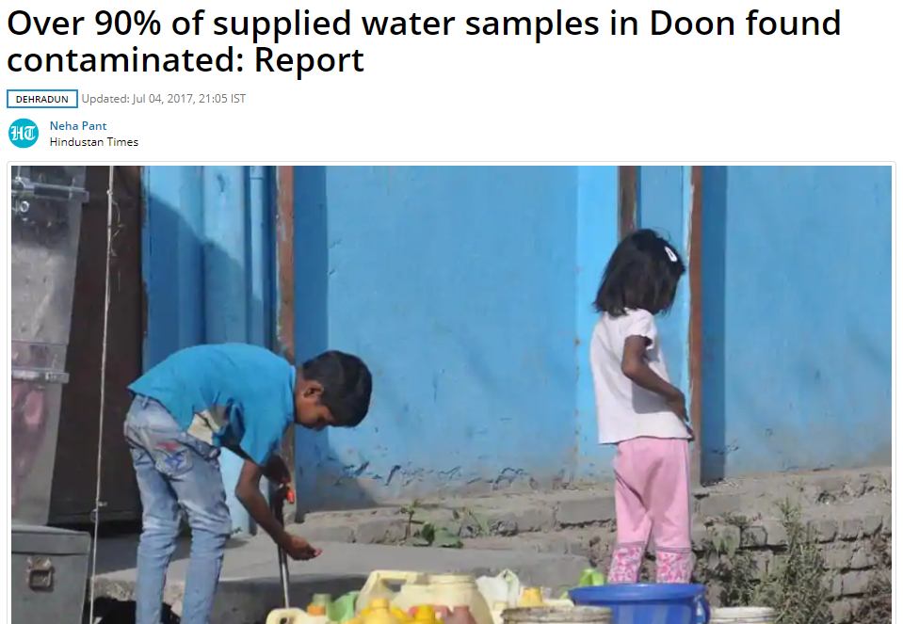
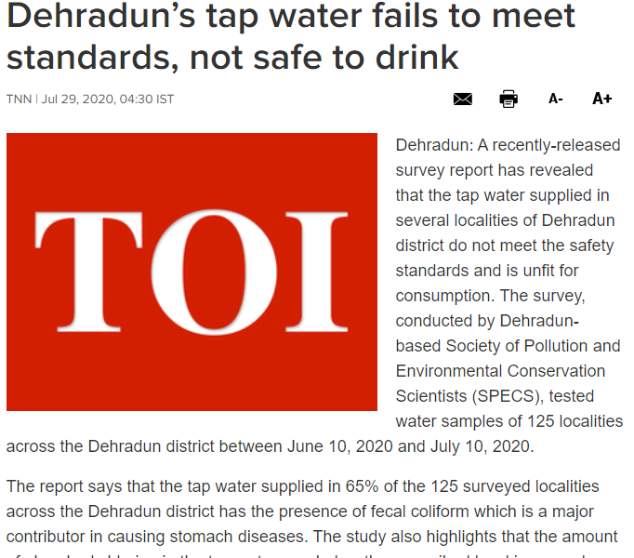
Problem statement - Water Supply Monitoring System
163
Million Indians don’t have clean drinking water
30%
Water’s lost due to leakages, equipment inaccuracies, aging equipment.
18917
Villages don’t have access for water supply
200K
Die every year due to contamination of drinking water in india
Team DevRushi Eco Projects
Notes:
Check more on water quality bro

Slide 3
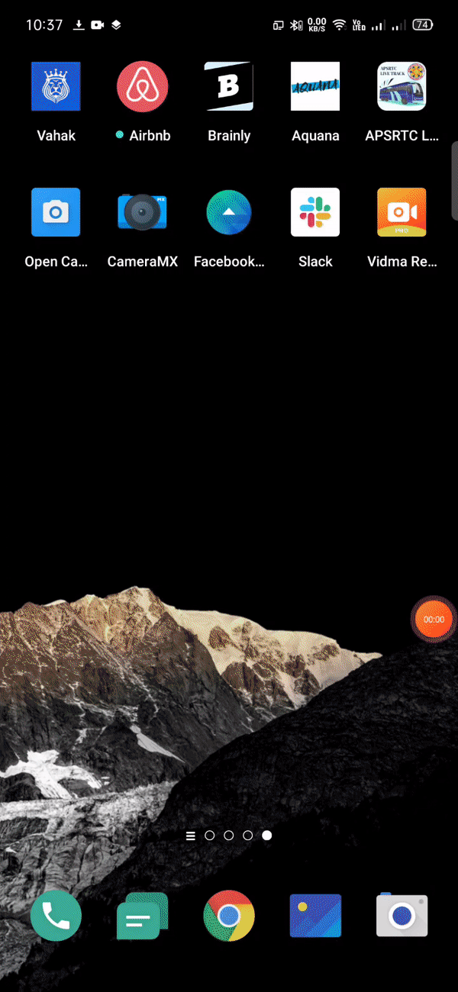
What We Solve ?
Our solution aims to solve three problems
Water Contamination
Water Leakage
Flood prediction and notification
Team DevRushi Eco Projects

Slide 4
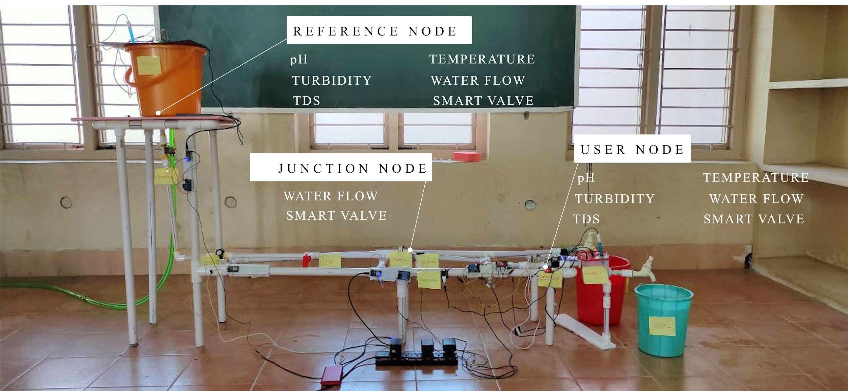
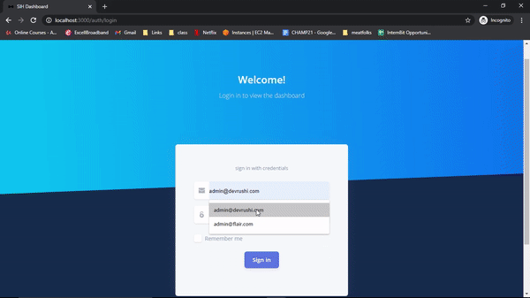
Overview of the Solution - Water Supply Monitoring System
Admin dashboard
Hardware configuration
Analyzed and modelled
Data sent to cloud, to admin
Leaks are identified using difference in flow rates between consecutive nodes
* Red line indicates there is a leak in that pipeline
** Water tank, junction and the houses are represented with respective icons
If water metrics deviate from standard values then there is contamination
Team DevRushi Eco Projects
Notes:
Add street or locality like bulk mangment

Slide 5
Hardware Prototype - Water Supply Monitoring System
Node | Metrics | Listeners
Reference | pH, Turbidity, TDS, Temperature, Flow Rate | Admin
Junction | Flow Rate | Admin
User | pH, Turbidity, TDS, Temperature, Flow Rate | Admin, User
Team DevRushi Eco Projects
Notes:
Whose this in the slides ?

Slide 6
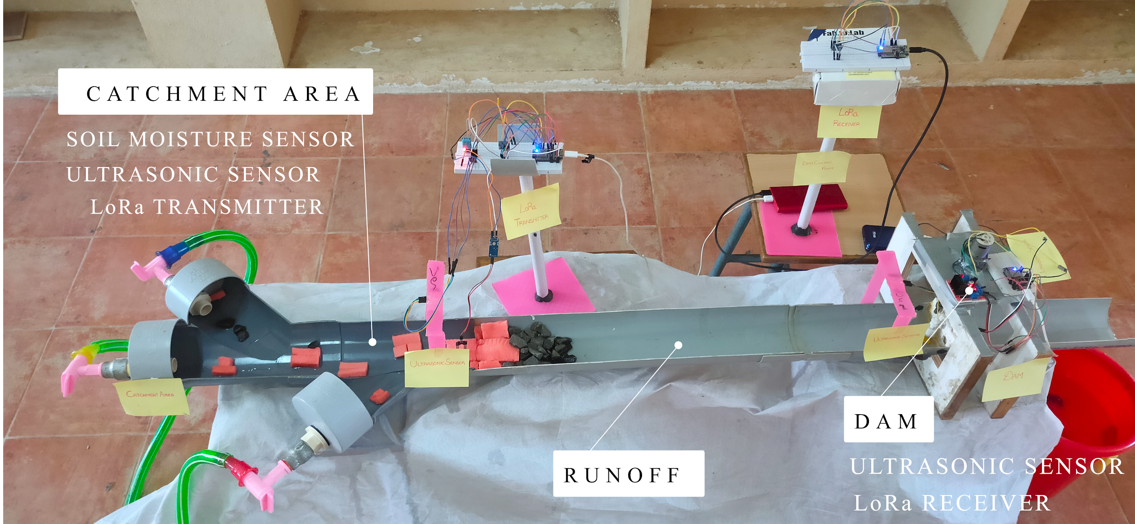
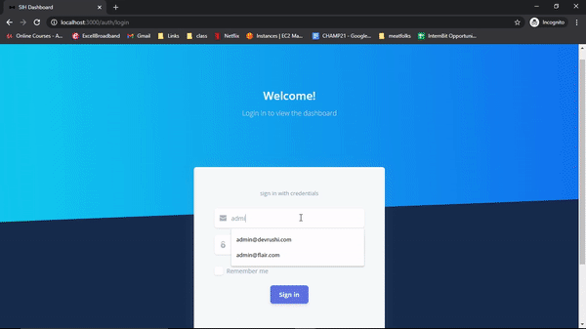
Overview of the Solution - Remote Sensing & Flood Prediction
Hardware configuration
Admin dashboard
Analyzed and modelled
Data sent to cloud, to admin
Works in networkless area using LoRa technology
Team DevRushi Eco Projects

Slide 7
Hardware Prototype - Remote Sensing & Flood Prediction
Predict rain using temperature and humidity
Notify when soil moisture is at 100%
Check for water level at the dam and catchment area
Notify when the water level is high or the gates are opened
Team DevRushi Eco Projects

Slide 8

The Idea ( Takeaways )
Nodes can be installed into existing grid.
Cost effective to install and works even in networkless areas
Three type of Nodes :
Reference Nodes
Junction Nodes
User Nodes
Nodes send data to cloud.
System detects contamination and leakages, alerts the admin and the user.
The users are sent real time stats of water quality and consumption.
Team DevRushi Eco Projects
Notes:
Check for a better word for the last existing grid

Slide 9
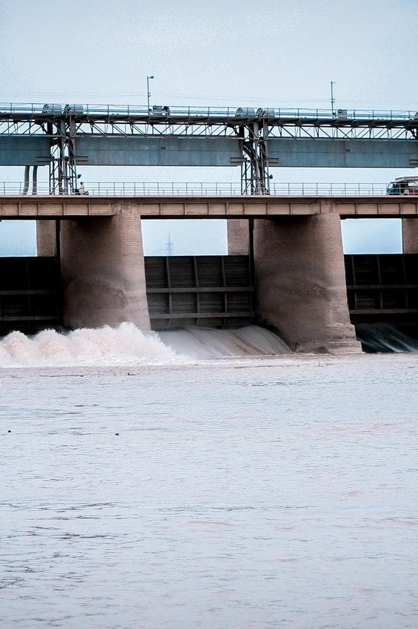
The Idea ( Takeaways )
Catchment area is constantly monitored for rain.
Water maybe released if water level at catchment and at dam cross threshold to compensate for excess water.
Gates maybe opened if capacity is exceeded .
Users are notified when the dam gates are opened.
D
Team DevRushi Eco Projects

Slide 10
Tech Stack
Software:
Flutter - User app
React Js - Admin panel
Mapbox - Maps
Firebase - Auth, Database
AWS IoT
Heroku ( Server Deployment)
Hardware:
Node MCU
ESP32
Analog pH Sensor
Turbidity Sensor
Analog TDS Sensor
Water Temperature Sensor (DS18B20)
Water Flow Sensor (YF-S201)
2 Channel 5V Relay Module
Electric Solenoid Water Valve
LoRa Transceiver Module (SX1278)
Ultrasonic sensor HC-SR04
Soil Moisture Sensor
DHT11 Sensor
MOTOR DRIVER (L298N)
TORQUE MOTOR (196 N-m)
Team DevRushi Eco Projects

Slide 11

Video Demonstration

Slide 12
Thank You
If you want to reach out to us
Mail us at devrushi41@gmail.com

Slide 13
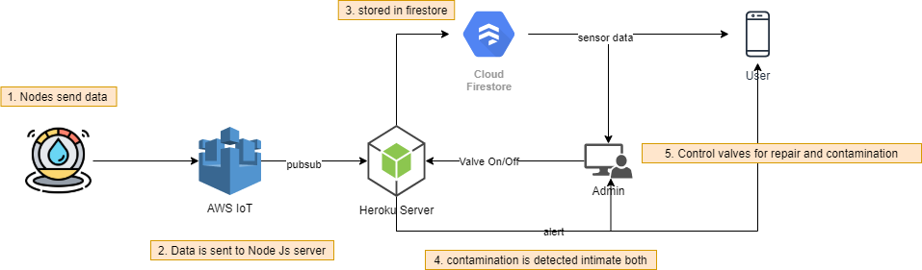
Architecture - Water Supply Monitoring System
If a permissible level of water leakage is crossed then the system alerts Admin with repair request
If the water is contaminated both the admin and user are alerted
Depends on both the data generated from
Reference nodes
Junction nodes
Features:
Reduces water wastage : supply and user ends.
Quick identity leaks & contamination
Works for all existing and growing cities.
Helps in well being of person.
Highly Scalable & Secure
Team DevRushi Eco Projects

Slide 14
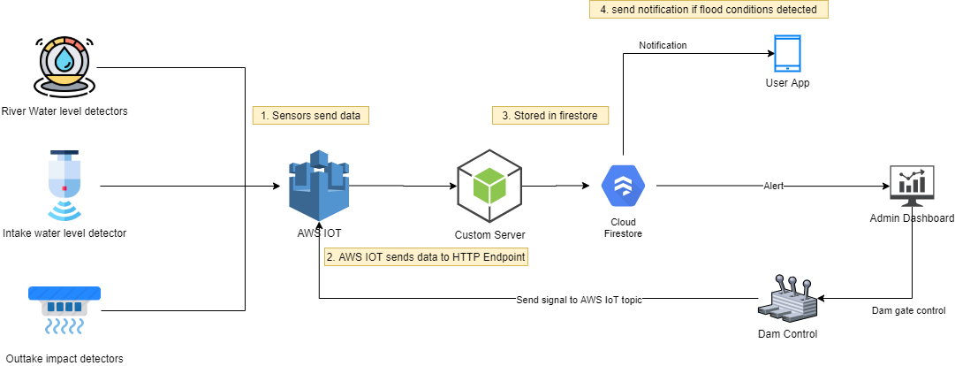
Architecture - Flood Prediction System
Environmental conditions at catchment area is constantly monitored for rain.
Water may be released if the water level difference is high
Users / Local People are notified about predicted flood or when the dam is opened
Features:
Predict floods early
Reduce accidents
Provide time to act if there is flood.
Used in many locations
Team DevRushi Eco Projects

